Slide 1
COSMOS Cluster 6
Embedded Programming and Robotics
Maxwell Lichtenstein
Andrea David
Amine Buchti

Slide 2
Roadmap
Introductions
Robot or not?
Intro to Roach Toolchain
Lab time: Hello World

Slide 3
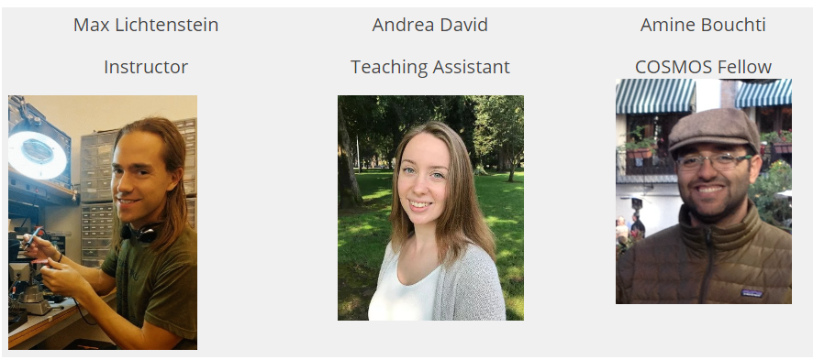
Your teaching staff

Slide 4

Robot or Not?

Slide 5
What is a robot?

Slide 6
What is a computer?

Slide 7
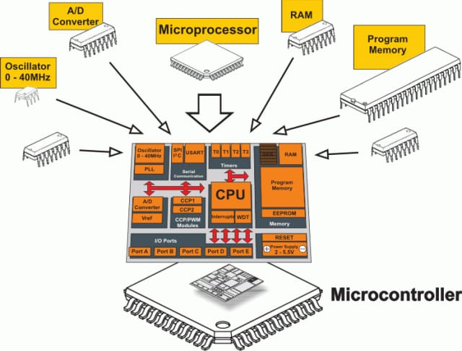
Microcontrollers

Slide 8
Microcontrollers vs Personal computers
Micro | PC
“System on a chip” – fits in one IC | Dis-integrated
Tiny (can be smaller than a grain of rice) | Not tiny
Little memory | Lots of memory
Cheap | Not cheap
Can interact directly with external electronics (pins) | Uses ports
Only runs 1 program and runs it all the time | Uses an OS to run many programs concurrently
PCs:
  Less tiny

Slide 9
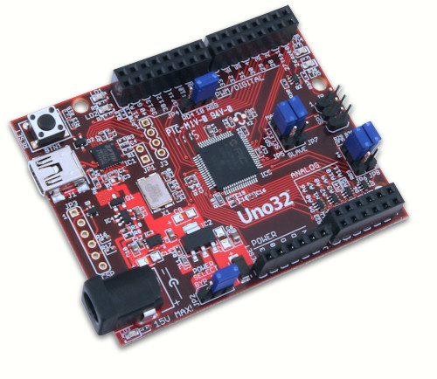
Uc32 and Roach

Slide 10
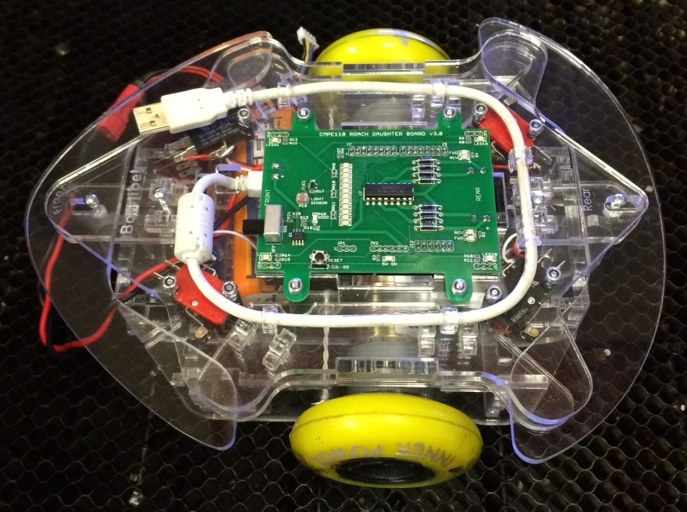
Roach Anatomy

Slide 11
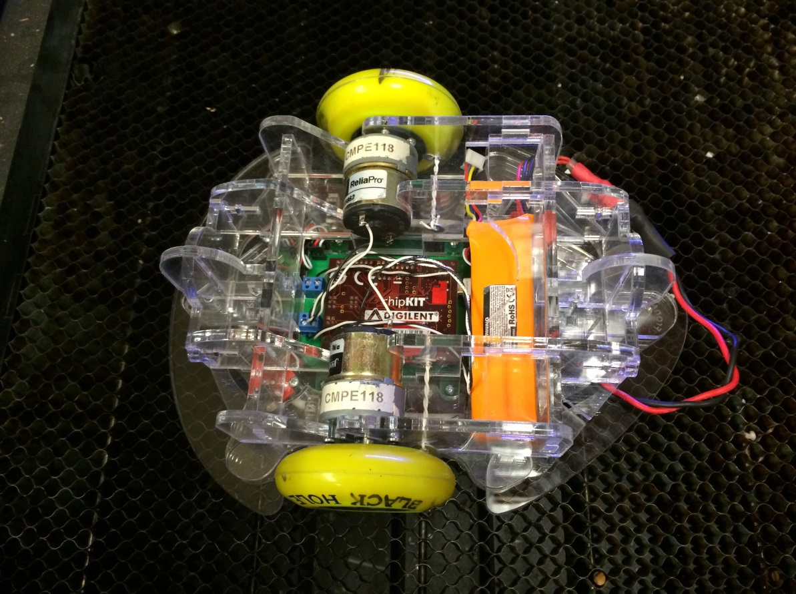
Roach Anatomy

Slide 12
Roach Toolchain
Step | Tool | Input | Output
Write code | MPLAB X IDE (Integrated Development Environment) | Your brain | .c files .h files
Compile | XC32 compiler | .c files .h files | .hex file
Bootloading | ds30_loader | .hex file (on desktop) | .hex file (on roach)
Testing | Serial Terminal Your brain and hands | Roach programmed with .hex file

Slide 13
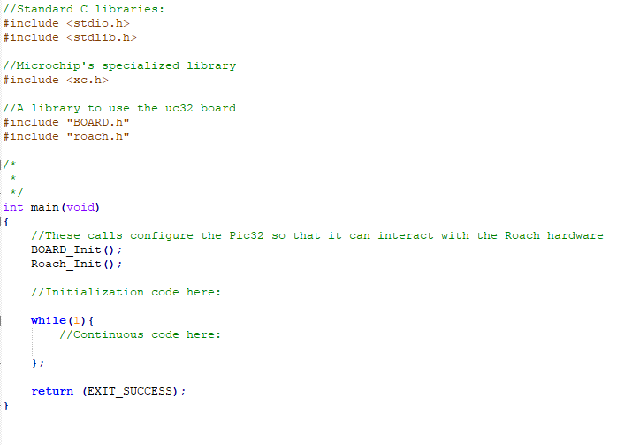
C Hello World

Slide 14
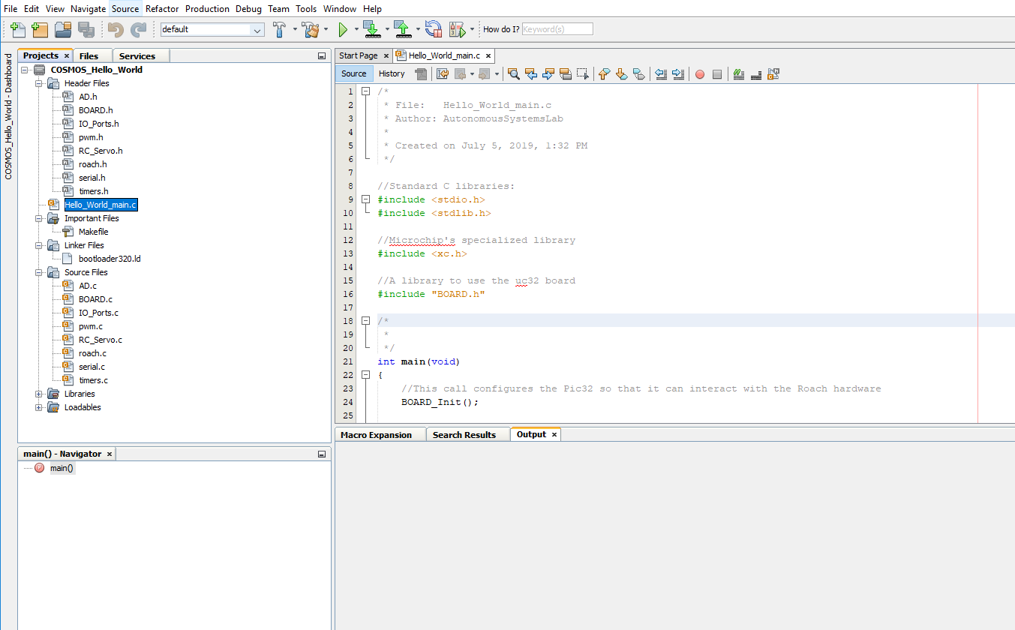
MPLAB X

Slide 15
Lab 1 Instructions
Meet partner
Find computer
Go to COSMOS website
  You can google “COSMOS UCSC Cluster 6”
  Go to Robotics -> Lab Materials -> download Lab1.zip
  Alternatively, https://www.dropbox.com/s/nqvqo9tw9onncfk/COSMOS_2019_Lab1.zip?dl=0
Unzip it
  Right-click ->unzip
Open Lab1.docx

Slide 16
Roach Etiquette
Prevent fall damage
  Roach should ALWAYS be:
    On a block
    On the floor
    In the maze
    In BOTH hands
Protect the battery
  Turn off roach power when not in use
  Replace undervoltage batteries immediately
Protect the circuitry
  No liquid near the roach
  Watch out for metal scraps
Don’t step on it
  Floor test in open areas
  Don’t leave unattended
  Watch your feet
Be nice
  The roach can hear what you say, so don’t say mean things about it

Slide 17
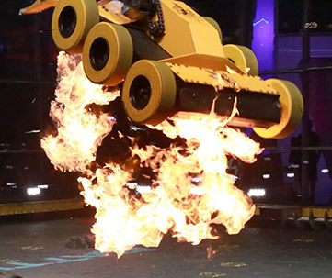
Lab Etiquette
“No Food”
No drinks besides water
Be careful with expensive things
Switch roles
Don’t make more of a mess
Be courteous in Jack’s Lounge

Slide 18
Final notes
Ask questions!
Experiment
Read error messages (or at least try to)
Freaky mouse bug
Have fun!

Slide 19
Lab Partners
['Julia ', 'Ashvin ']
['Annie ', 'Shize ']
['Serena ', 'Max ']
['Lillian ', 'Joshua ']
['JJ ', 'Natasha ']
['Jose ', 'Florence']
['Abhigna ', 'Katie ']
['Tianyi ', 'Afra ']
['Aaron ', 'Andrew ']
['Helen ', 'Austin ']
['Wonjin ', 'Kelly ']
['Steven ', 'Namya ', 'Natalie ']

