Slide 1
COSMOS 2019
Project Groups and Initial Design

Slide 2
Roadmap
Project Discussion and Clarifications
Group assignments
Group work:
  Brainstorm Session
  2 or 3 proposed designs
  Present designs to class
  If time is available, start work in lab

Slide 3
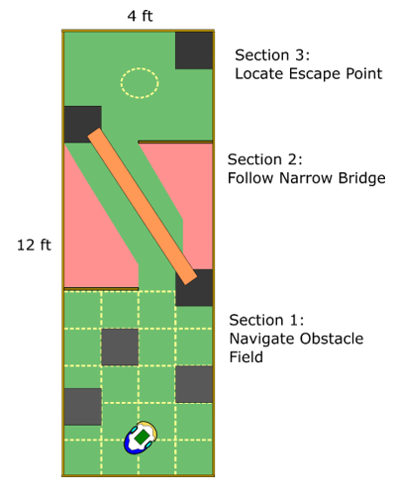

Slide 4
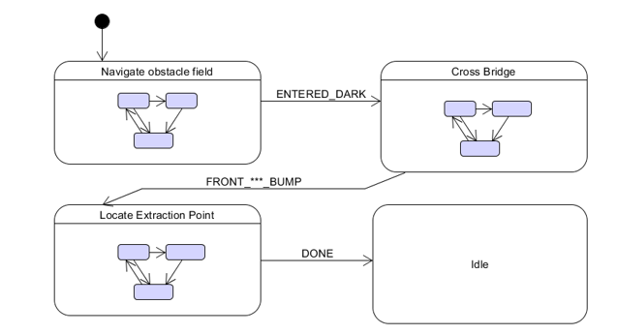

Slide 5
Hierarchical State Machines
Way to “nest” state machines
Allows developing some functionality independently of other parts of the system
Saves a lot of typing and debugging

Slide 6
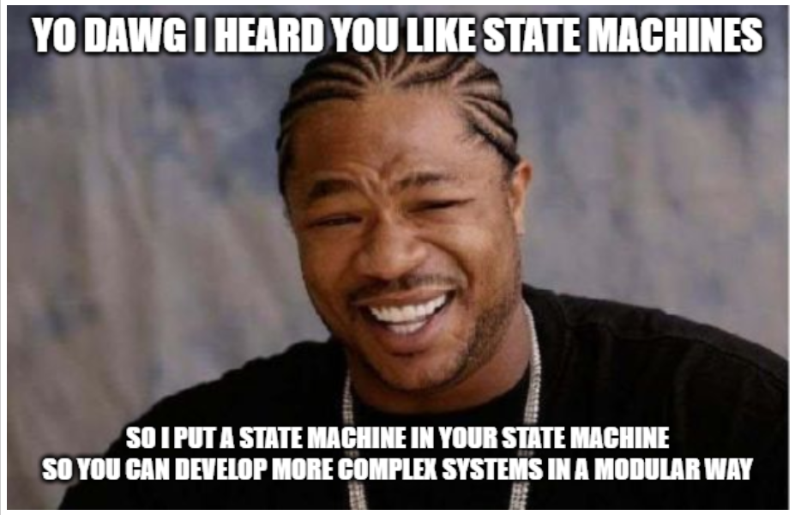

Slide 7
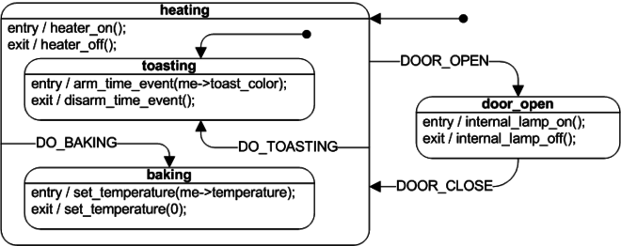
Hierarchical State Machines

Slide 8
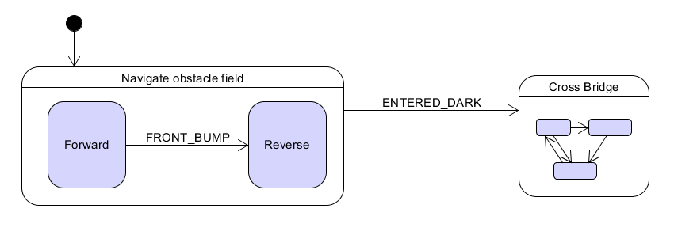
Roach Example:

Slide 9
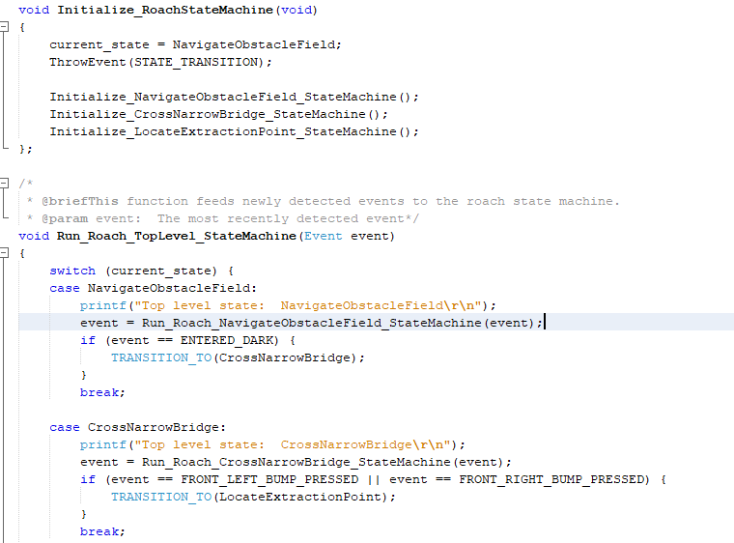
Project Framework

Slide 10
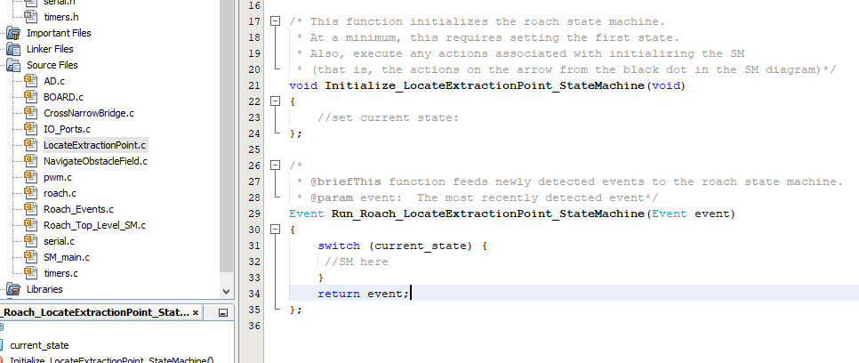
How to develop on the framework:

Slide 11
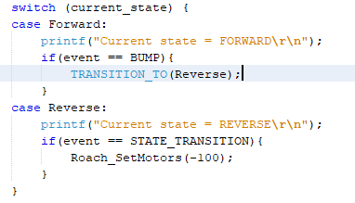
Changes:
TRANSITION_TO(), STATE_TRANSITION event

Slide 12
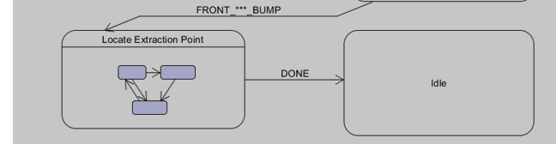

Changes:
ThrowEvent():

Slide 13
Project Discussion
Any questions?
Any suggestions/requests?

Slide 14
Today’s Schedule:
As a team:
  Come up with a team name
  Each team comes up with 2 – 3 state machines
    State machines should be distinct (try to make them as radically different as possible!)
    For IMU team: Make or find 1 an I2C or SPI state machine
    Some teams will need to write services, as well. Give an overview of your service
Lab time
  When (IF) you finish SMs and services, you can go to lab
  Please choose computers respectfully!

Slide 15
Hardware notes
For teams 3a, 3b:
  Only 1 rangefinder roach (US) is ready to go right now
  Roaches with IMU, IR sensors will be ready tomorrow
Field in progress
  Should be finished by tomorrow

Slide 16
Final Tips
Take breaks
Communicate
Delegate tasks
Ask for help

Slide 17
TEAMS:
Avoid Obstacles 1:
  Afra, Katie, Natasha, Julia, Lillian
Avoid Obstacles team 2:
  Eric, Austin, Helen, Max
Cross Bridge team 1:
  Natalie, Namya, Jose, JJ
Cross Bridge team 2:
  Abhigna, Kelly, Wonjin, Annie, Andrew
Locate Extraction Point with rangefinder:
  Serena, Florence, Steven
Locate Extraction Point with IMU:
  Joshua, Ashvin, Daniel, Aaron

